Slide 1

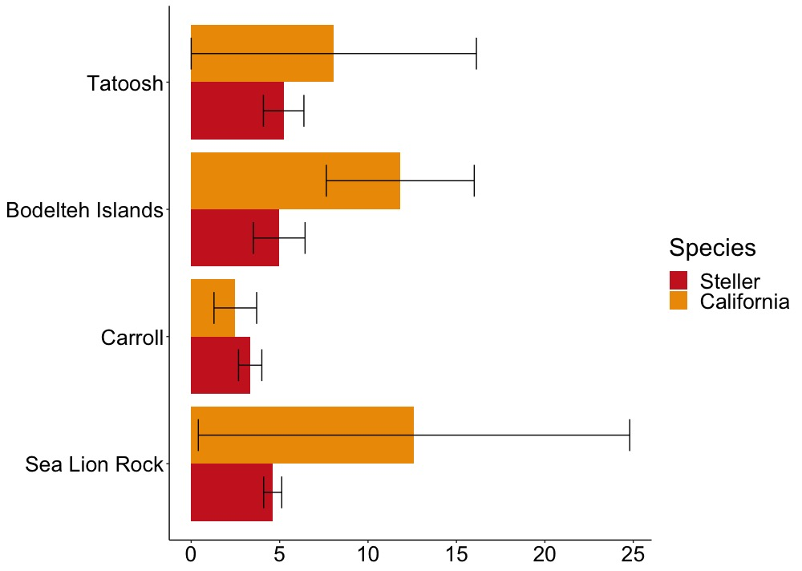
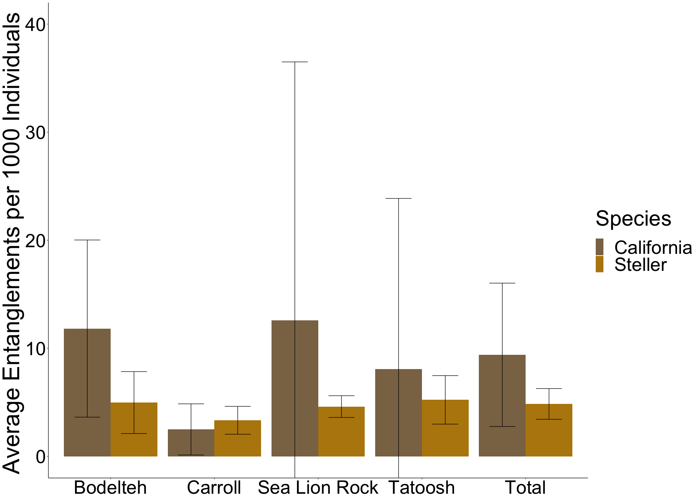
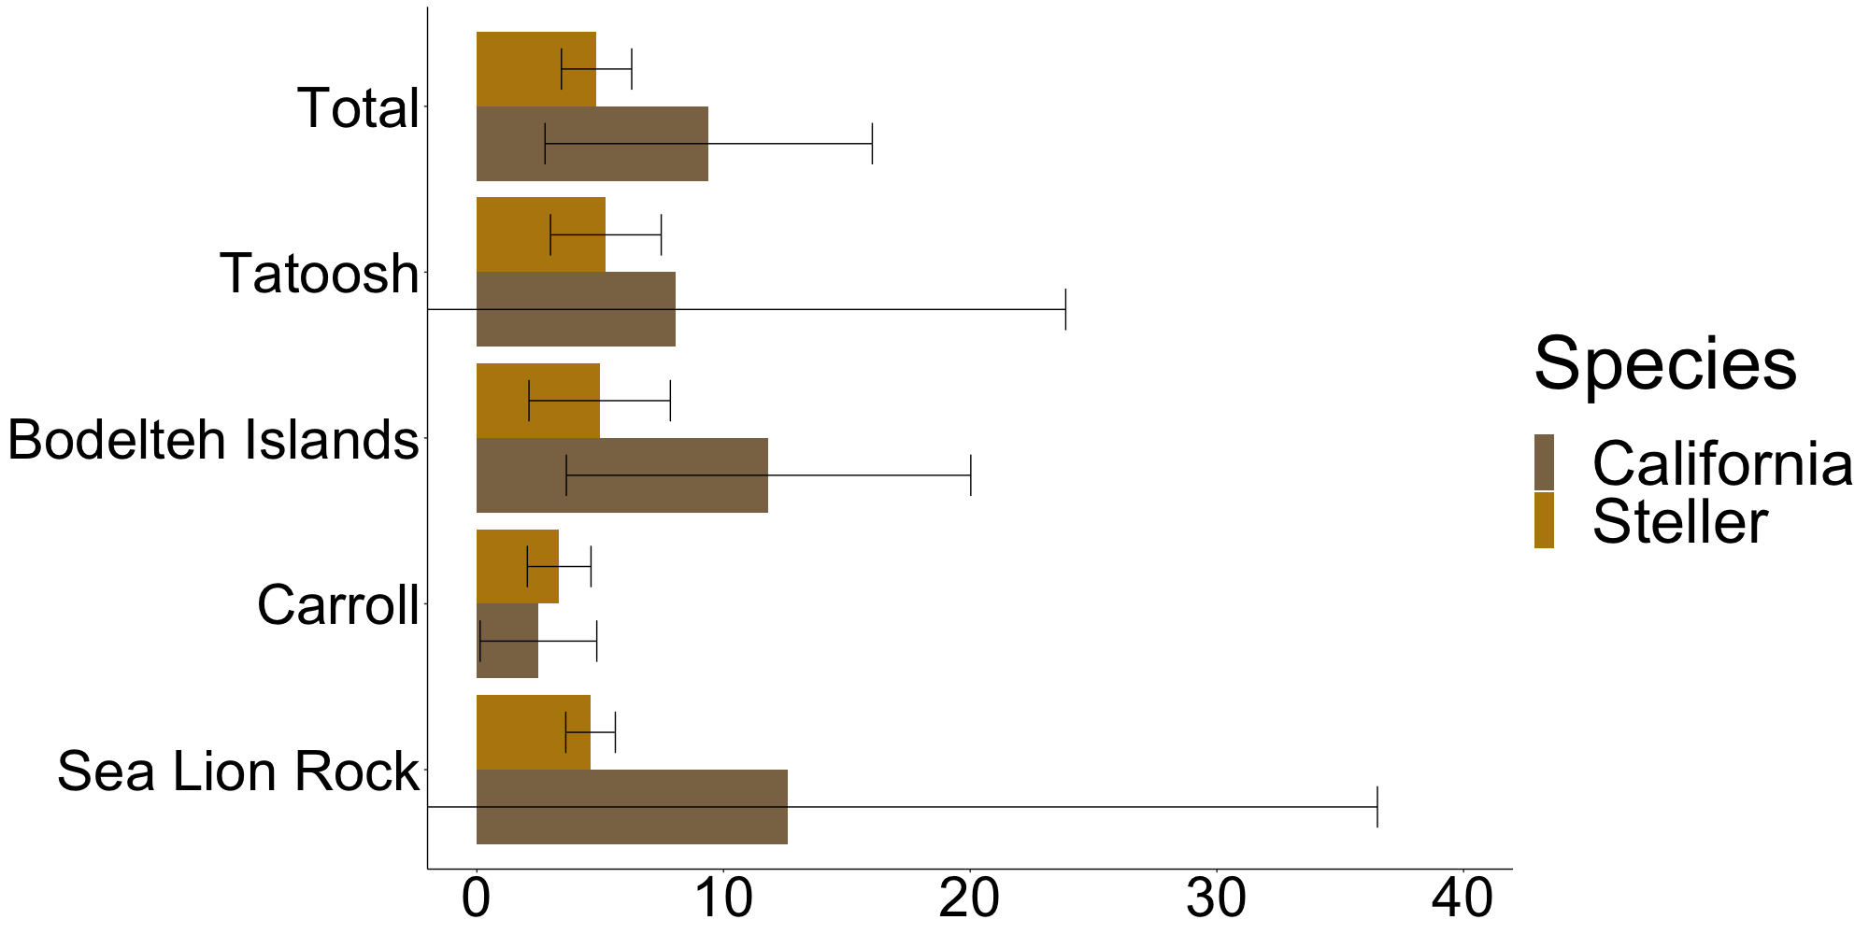
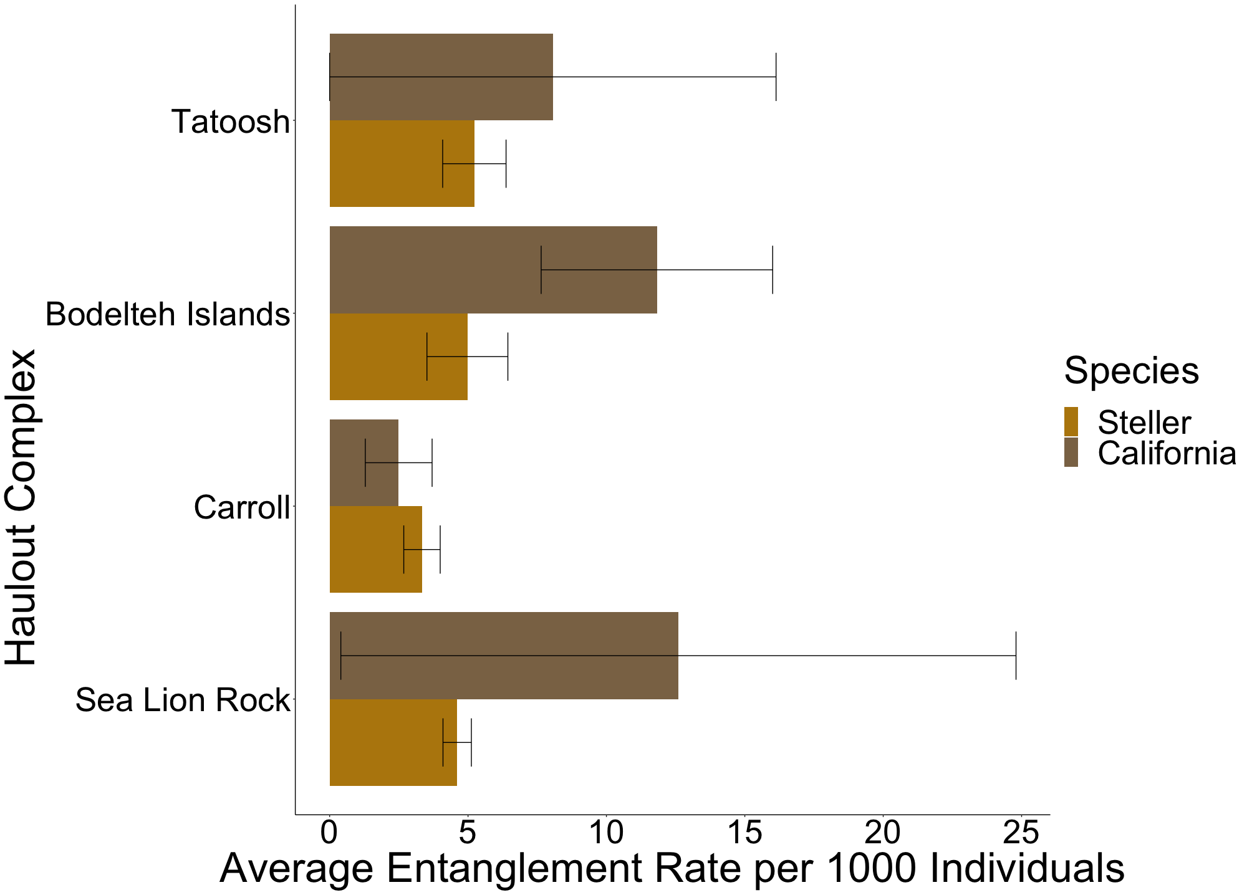
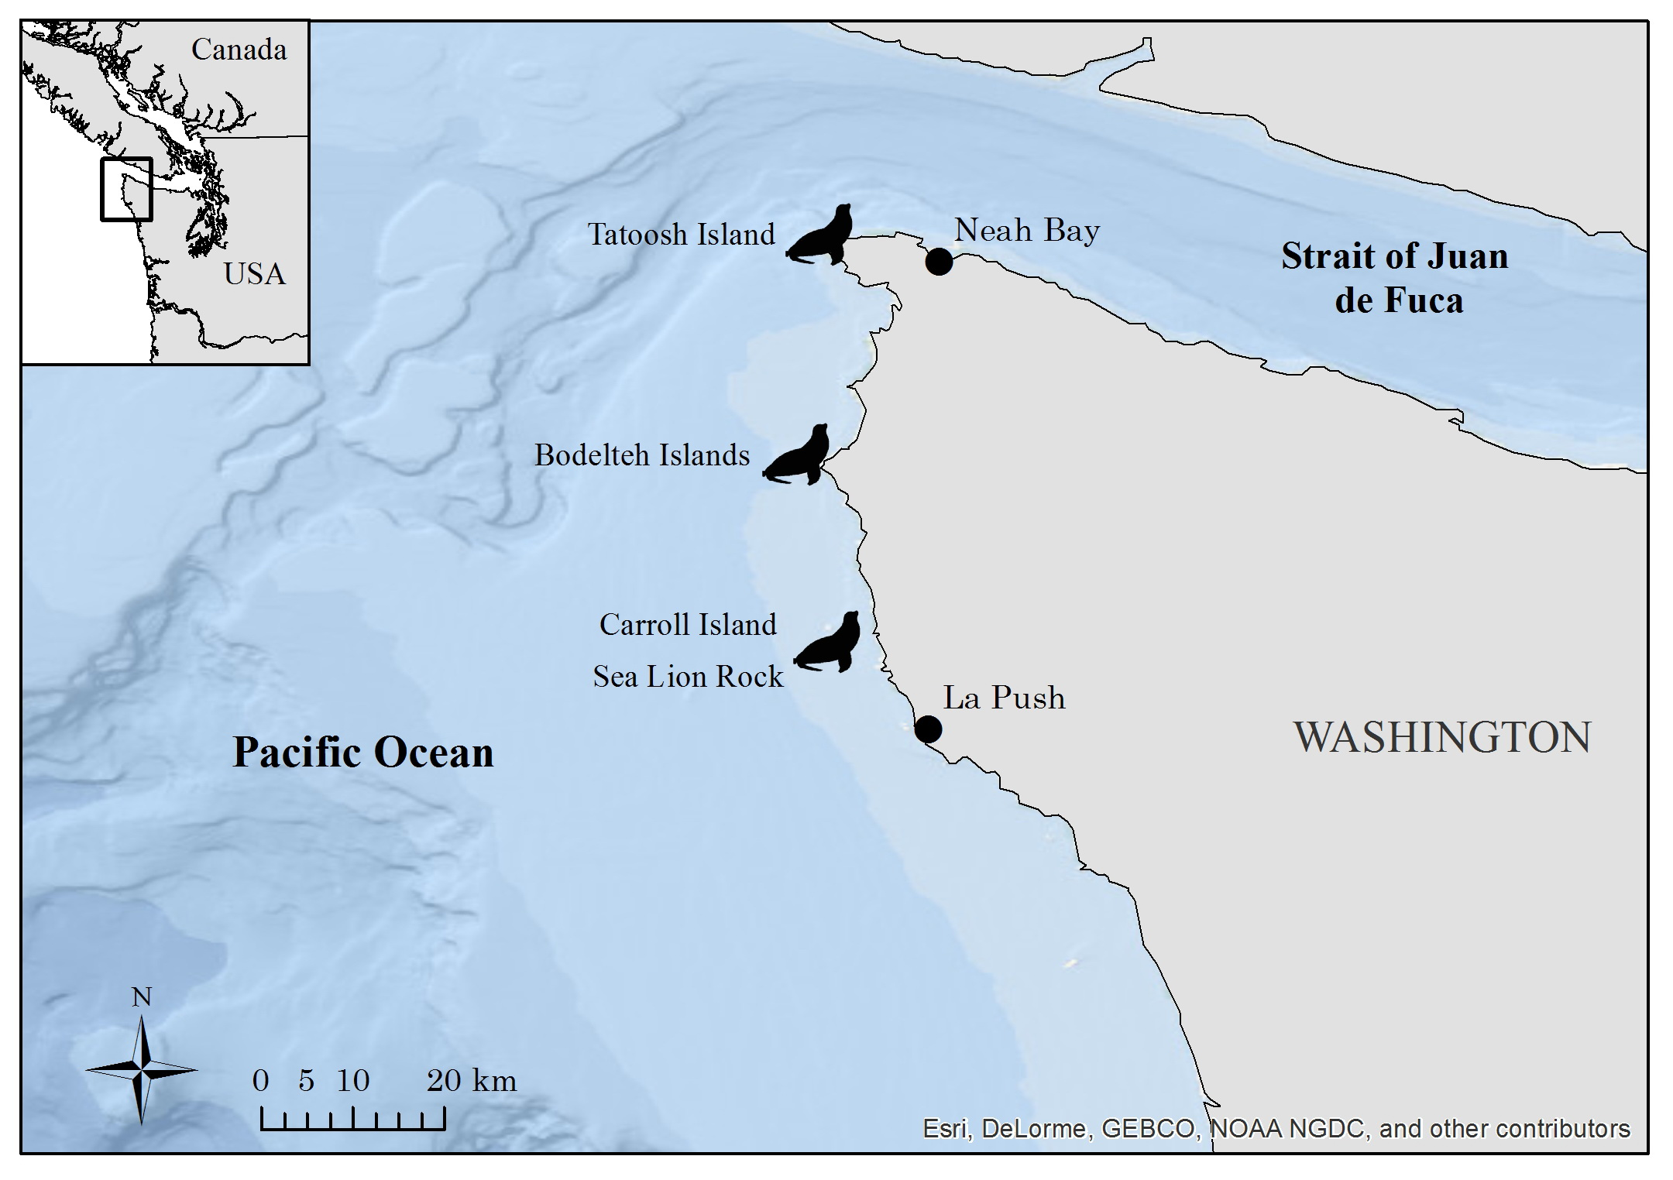
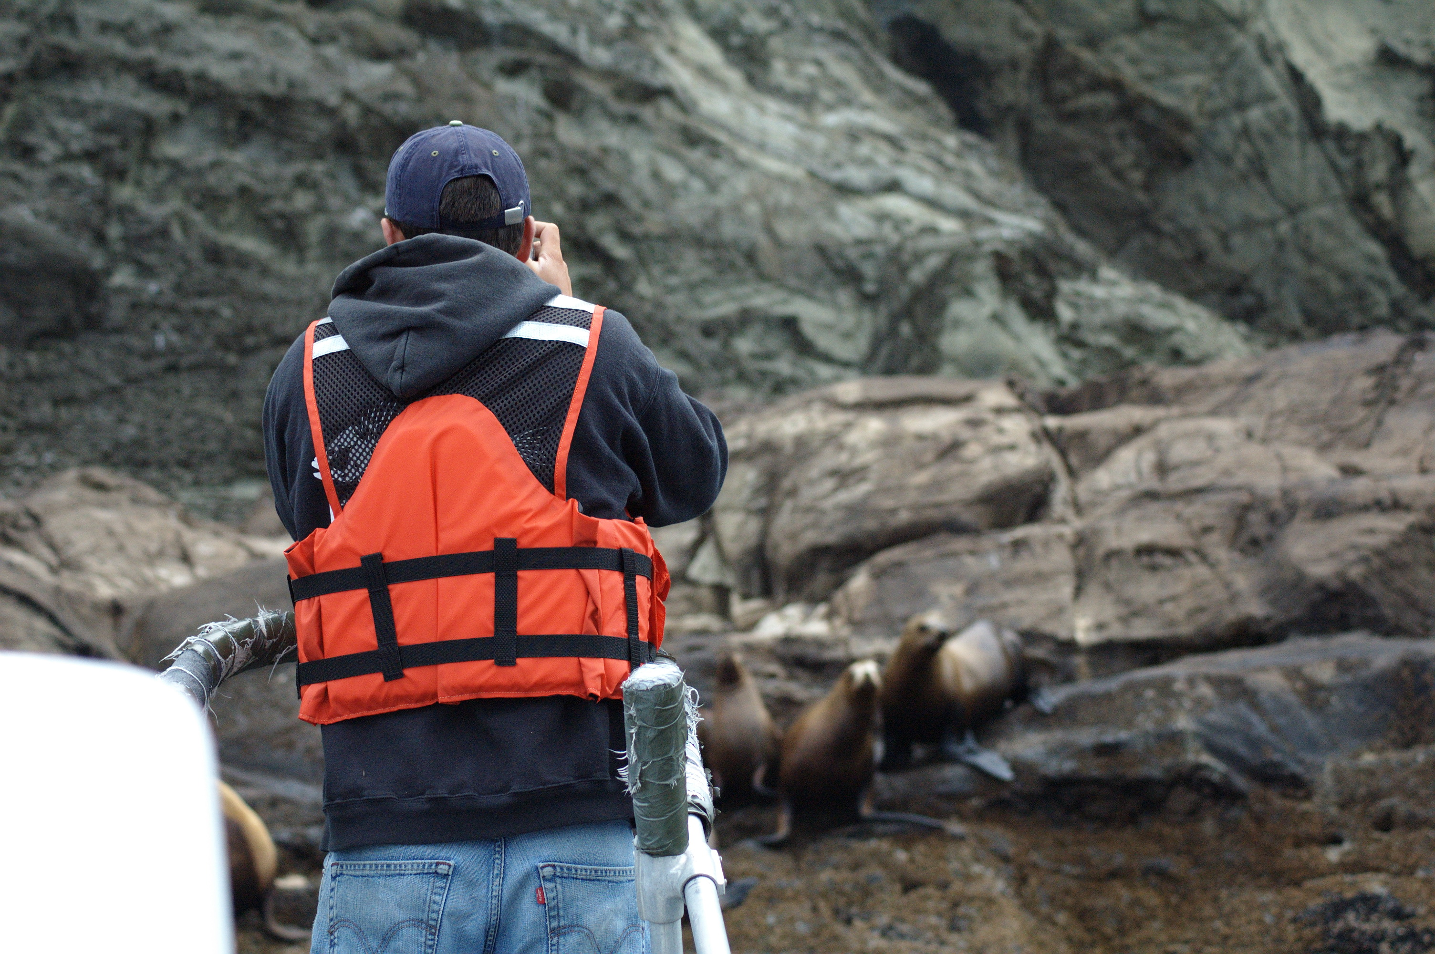
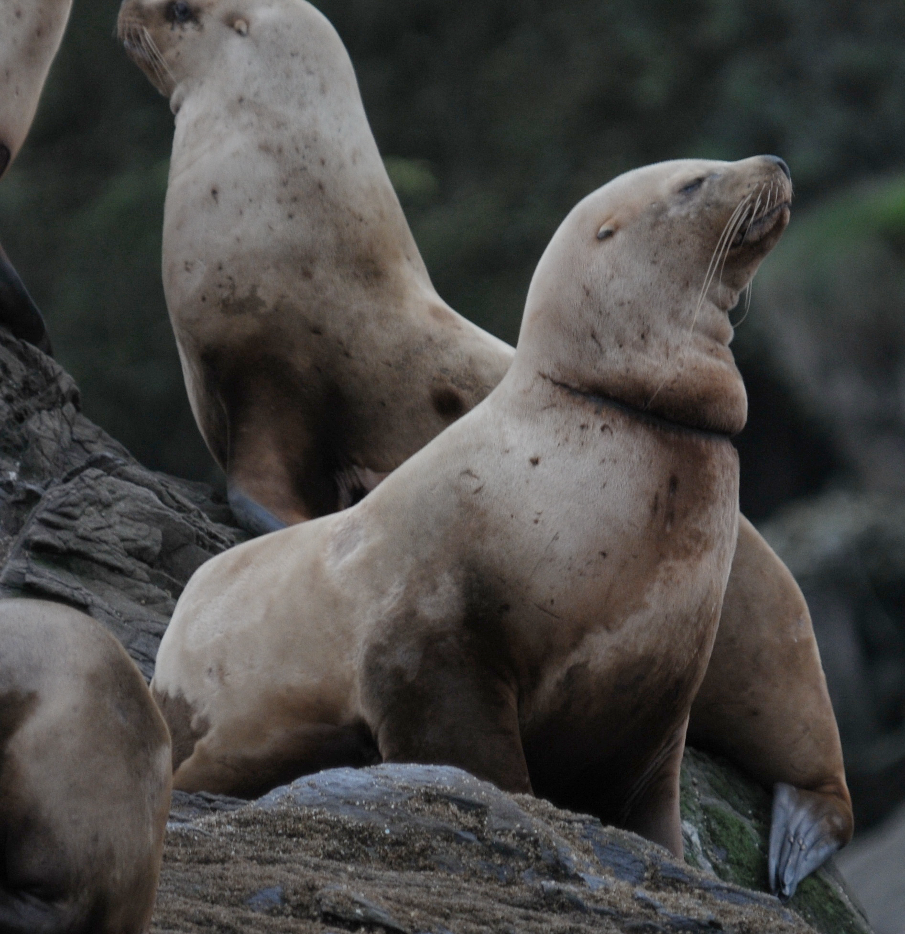
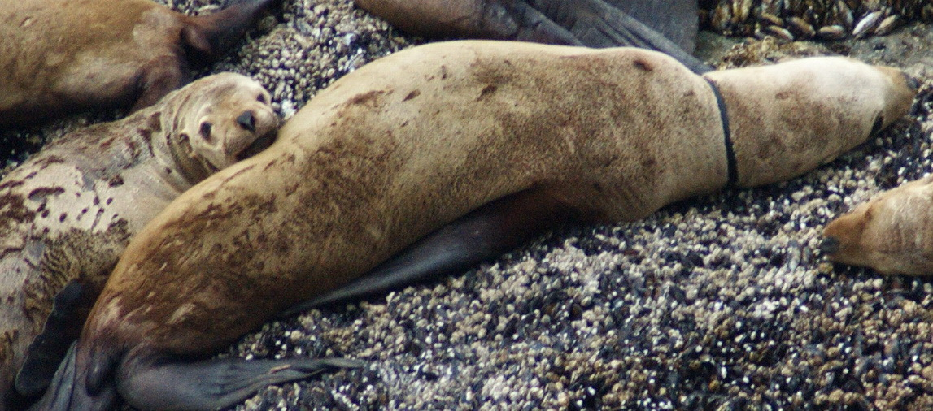
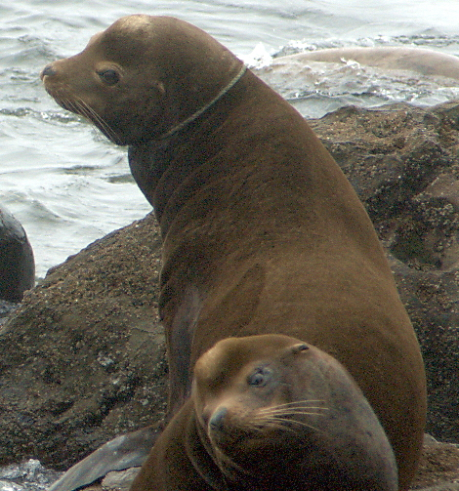
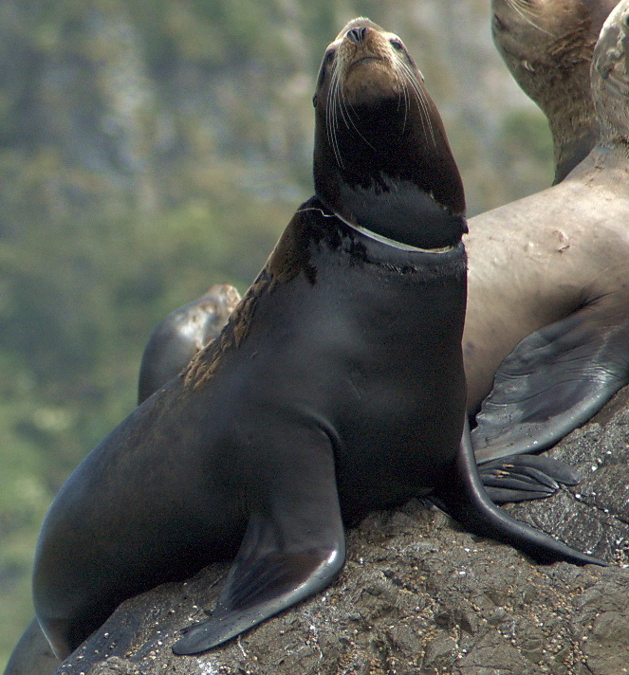
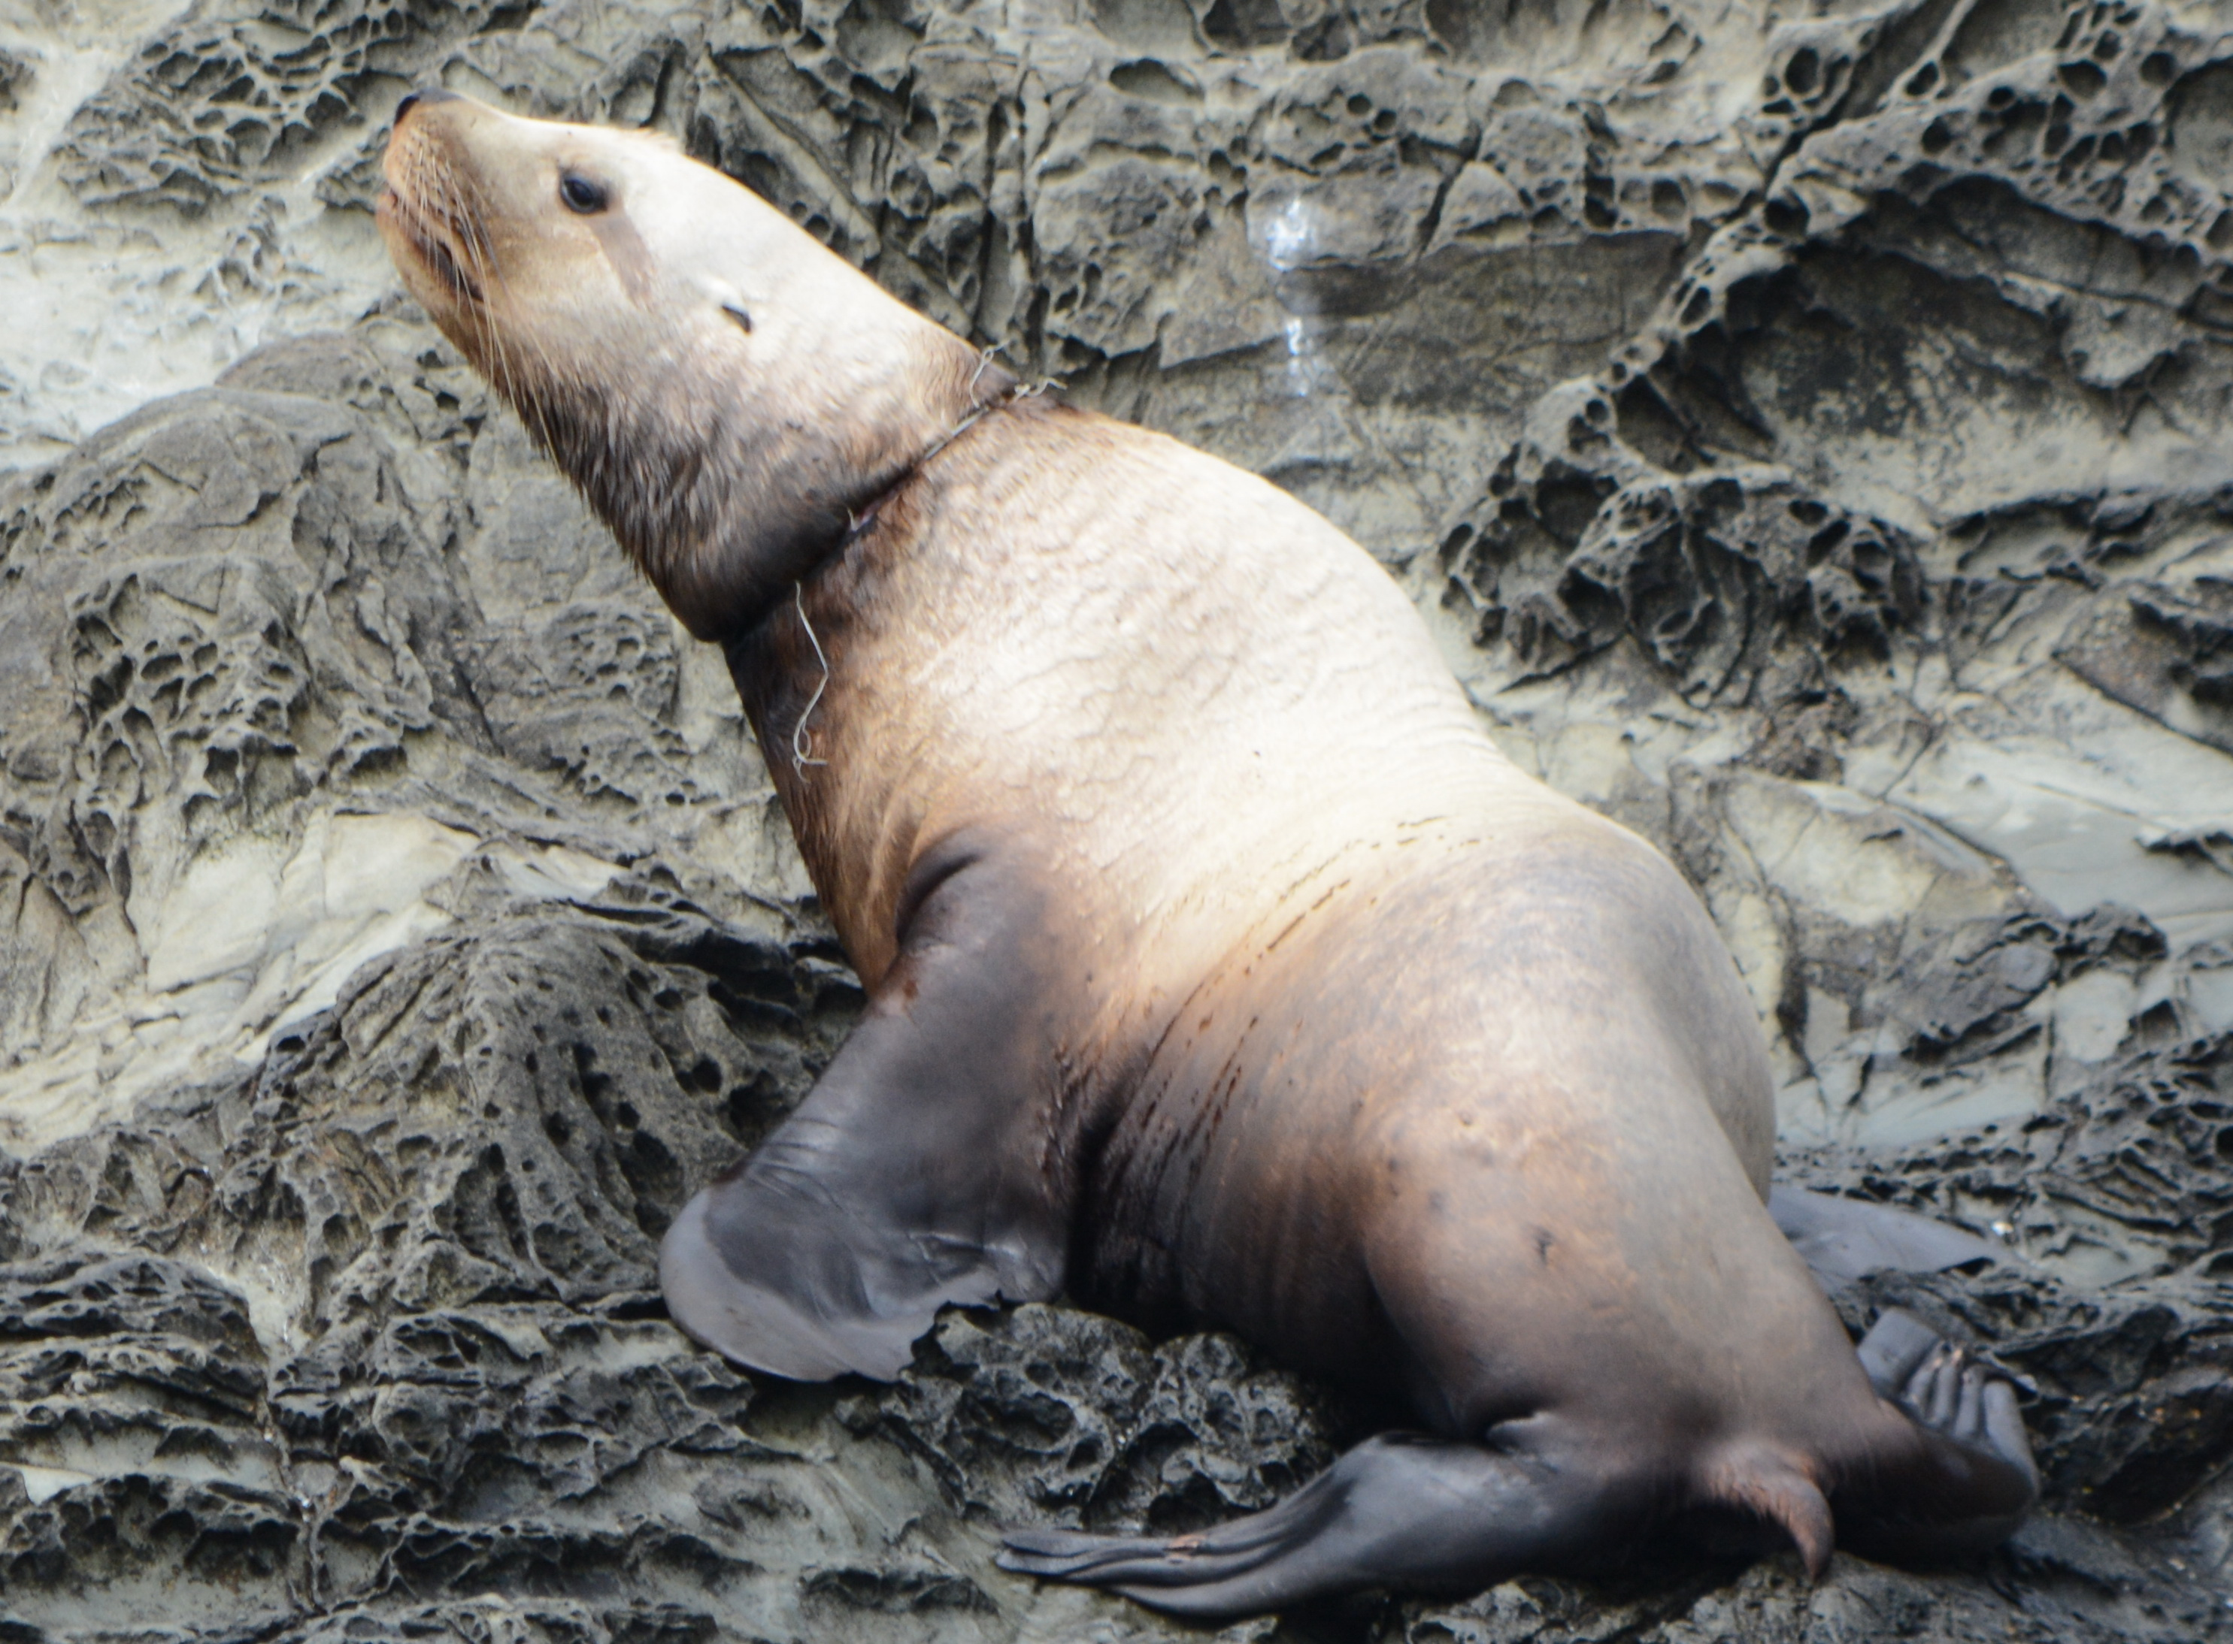
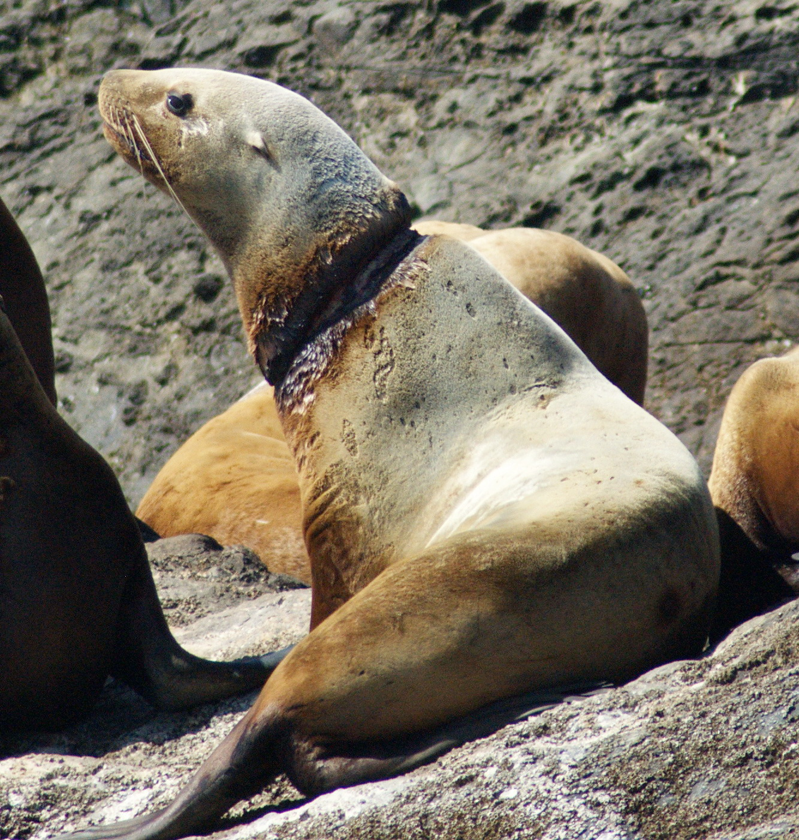
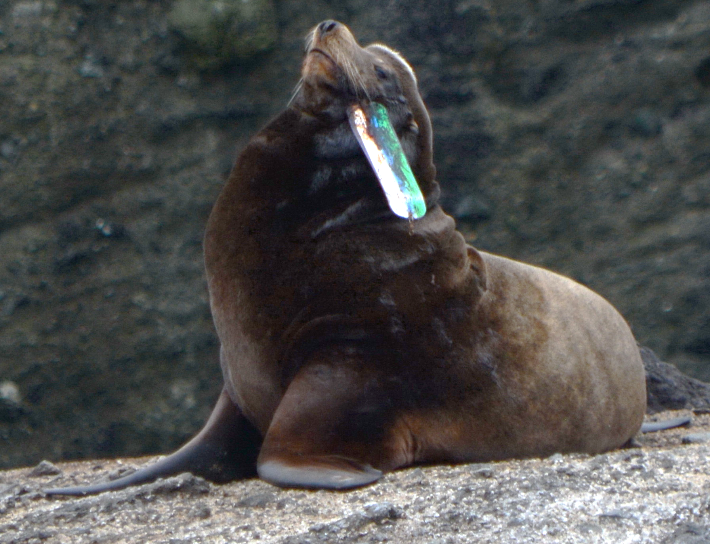
Rates and causes of entanglement in Steller and California sea lions
on the north coast of Washington
Elizabeth Allyn & Jonathan Scordino
Makah Tribe, PO 115 Neah Bay, WA
Liz.allyn@makah.com
Introduction
Results
Conclusions
Marine mammals are impacted by marine debris in many ways, one of which is entanglement. Entanglement is a significant welfare issue for many species, and is even thought to cause population-level concern for some. This study documented entanglement rates and common sources of entangling materials for sea lions on the north coast of Washington.
Research Questions:
What proportion of sea lion populations at northern Washington haulout complexes (Tatoosh, Bodelteh Islands, Carroll, Sea Lion Rock) are entangled?
What are the most common entangling materials?
Are there annual trends in overall entanglement rates?
The overall entanglement rate was 6.4/1000
The number of entanglements stayed statistically consistent over the study period.
The peak in entanglements occurred in June-September.
78.3% of entanglements were active (entangling material present) during observation.
Entangling materials could not be identified in 50.9% of all active cases.
Packing bands made up the majority of identifiable entanglements (68.3%) year-round, followed by flashers (11.8%), which were observed only during June – September.
Identified Entanglements Per Unit Effort By Material
Our low observed rates of entanglement are similar to rates reported in other regions, and indicate that entanglement is unlikely to be causing population level impacts on either Steller or California sea lions. However, entanglement is still a welfare concern for both species. Entanglement rates stayed statistically consistent over the study period, though looking at trends in availability of entangling materials in the environment could provide context to any annual fluctuation. The peaks in overall entanglements and in flasher-caused entanglements occurred in June-September, which overlaps with seasonal fisheries. The most common entangling material was packing bands, which could be from either fishing and non-fishing related sources. Additional research should focus on packing band design to make them less likely to cause entanglements when they enter the marine environment.
Further questions:
Do sex or age affect entanglement rates?
Have past education efforts about marine debris and entanglement risk impacted entanglements locally?
Do trends in observations of packing band entanglements correlate with the occurrence of packing bands during beach debris surveys?
Occurrence of Identified Entangling Materials
Entanglement Rate per Species and Complex
a.
Entanglements Per Unit Effort
Haulout Complex
Number of Entanglements
Entanglement Rate By Species and Complex
b.
Entanglement Rate per 1000 Individuals
Figure 2: Average entanglement rates for Steller and California sea lions at each of the four haulout complexes.
Haulout Complex
Figure 2: Average entanglement rates for Steller and California sea lions at each of the four haulout complexes
Methods
Entanglements Per Unit Effort
Photos of entangled individuals and total counts of individuals were taken during small boat surveys of sea lion haulouts on the Washington coast from 2010-2018.
Photos were analyzed to determine species of sea lion entangled and to identify the material and severity of entanglement.
Number of Entanglements
Average Entanglements per 1000 Individuals
Average entanglements per 1000 individuals for each haulout complex and species. Error bars indicate 95% confidence intervals. No statistical effect of haulout or species on entanglement rate was found.
c.
Entanglement Rate per Species and Complex
Active and Inactive Entanglements Per Year
Map of sea lion haulout complex sites surveyed along the north coast of Washington State (left); JH on survey (below)
Entanglements Per Unit Effort
Number of Entanglements
Number of Entanglements
Acknowledgements
Figure 4: Proportion of entanglements caused by an unidentifiable material in each wound severity category.
We would like to thank Wendy Szaniszlo for providing training for entanglement severity and material identification. Field assistance was provided by AA, MG, PG, and JH. Funding from the Species Recovery Grant to Tribes (NA16NMF4720059)
Year
Figure 2: Average entanglement rates for Steller and California sea lions at each of the four haulout complexes
(a) Occurrence of identifiable entangling materials for Steller and California sea lions by month; occurrence of entangling materials by year for Steller sea lions (b) and California sea lions (c). Note that the entangling debris could not be diagnosed for 59.6% of entanglements.
Year
Number of active (entangling material present) and inactive (healing or scarred) entanglements per year. No statistical difference was found in the number of entanglements by year or active/inactive status.
Figure 1: (a) Occurrence of entangling materials for Steller and California sea lions by month; occurrence of entangling materials by year for Steller sea lions (b) and California sea lions (c). Note that the entangling debris could not be diagnosed for 59.6% of entanglements.
Steller
Rubber Band
Steller
Scar
Figures show example entanglements and the associated species and material determinations
California
Rope
California
Packing Band
Steller
Packing Band
Steller
Unknown
California
Flasher
Figure 4: Number of active (entangling material present) and inactive (healing or scarred) entanglements per year
Tribal Habitat Conference 2019
Notes:
Copyright Colin Purrington (http://colinpurrington.com/tips/academic/posterdesign).

